Slide 1

Introduction to C#

Slide 2
About this Class
Introduction to C# programming and software development.
Goal start making things in C#, without being an expert.
Not enough time to teach a lot
Providing lots of examples for you to play with
Designed especially for construction technology professionals
Recommended IDE is “Visual Studio 2022 Community”

Slide 3
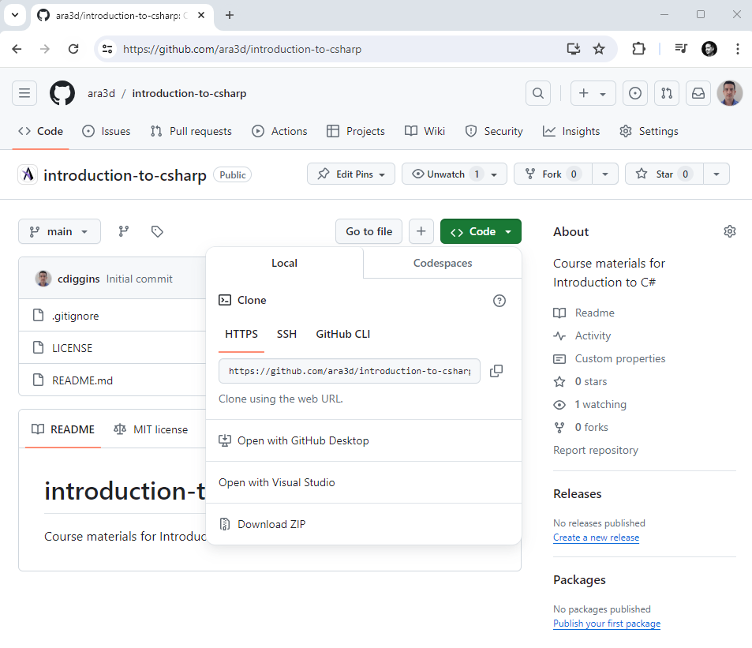
Course Material is Online

Slide 4
But I don’t get Git 😰
Don’t worry! You don’t need to learn Git.
Just download the whole repository.
However, it is worth learning the basics!
Git is useful for backing up and versioning code

Slide 5

About You
You are relatively new to programming
Maybe some Python experience
Programming is not your full-time job
You just want to learn quickly
You use Windows

Slide 6

About Me
My name is Christopher Diggins. I operate Ara 3D, a software development company.
Programming computers for 40 years. Some things I might take for granted, stop me if things aren’t clear
I enjoy programming, and I want you to enjoy it as well!

Slide 7
Takeaways
Libraries and tests are secret weapons
Learning 20% of the language and tools can be sufficient
Practice, practice, practice

Slide 8

Structure of C# Code
Using a Unity Script as an Example

Slide 9
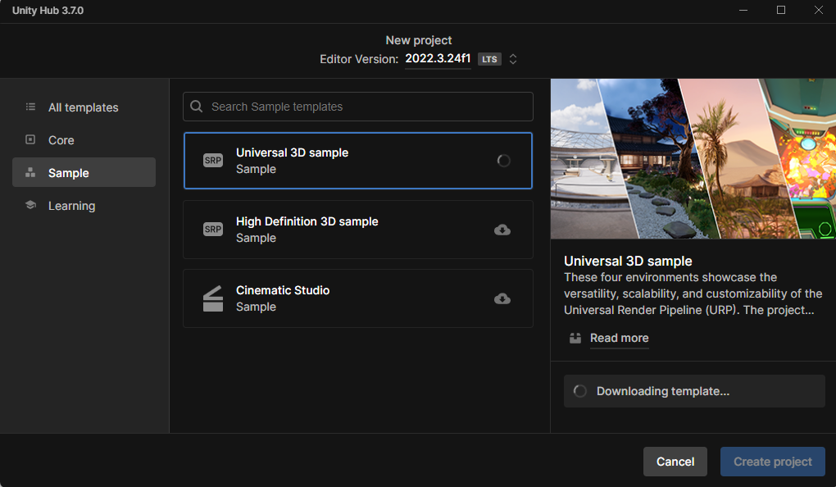
Get the Universal 3D Sample using Unity Hub

Slide 10
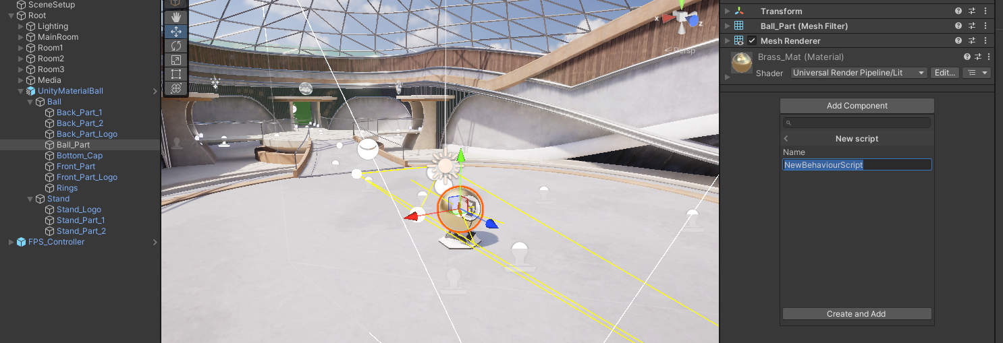
Add a Script Component to Game Object with a Mesh

Slide 11
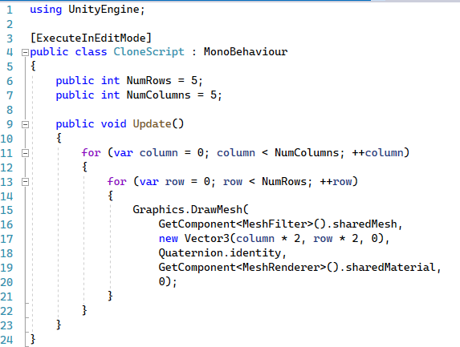
My First Unity Script

Slide 12
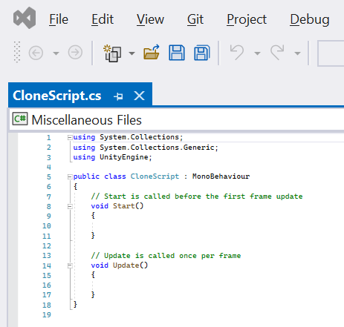
Using Declarations
The “using” declaration says what library parts are used in the current file.
Extra functionality is provided by libraries.
Libraries are organized using “namespaces”.
For example: two things called “List” might exist in different libraries.
Namespaces disambiguate: “MyLibrary.List” and “System.Collections.List”.
Delete them and see what happens.

Slide 13
Class
A class describes a particular type of object.
Objects contain data and provide operations for accessing or transforming that data.
This is part of object-oriented programming (OOP) and will be covered in depth on later classes.
In Unity, all scripts are classes.

Slide 14
Inheritance
In Unity all scripts are classes that inherit from a Unity class called “MonoBehavior”.
This means that the things that a MonoBehavior can do, and the values that it contains, are accessible to the new class.
This is called inheritance and is a feature of object-oriented programming (OOP).

Slide 15
Comments
Comments are for humans and have no impact on programs.
The compiler ignores everything from the “//” until the end of the line.
C# supports multi-line block comments using “/*” and “*/”
The C# compiler can generated help documents if you use XMLDoc format.

Slide 16
Functions
The start function is called by Unity once when the game starts.
The update function is called by Unity every frame of the game.
They are not called when the game object is deactivated.

Slide 17
Attribute
Meta-information for the compiler or host environment.
Available through Reflection.
Tells the script to run in editor even when the game is not playing.

Slide 18
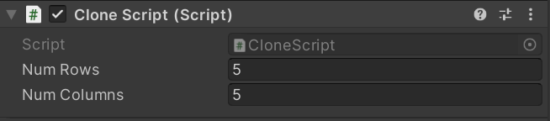
Fields
A field is named data associated with an object. Also known as a “member variable”.
When declared as “public” exposed in the editor as a property.

Slide 19
Variable Declaration
A variable is a name associated with a value.
The value associated with the name can change.
However, the type of data (number, text, vector) associated can’t be changed.
You can use the variable name instead of expression.

Slide 20
Expressions
A sequence of symbols (operators, numbers, variables) that represent computations. They are transformed into values (evaluated) when the program is executed.
Some examples include:
Numbers: 42, 3.15
Booleans: true, false
Variables: x, MyVector, this_is_a_variable
An operation with operands: x + 1, y >= 12, -z
Parenthesized expression: 3 * (y – 2)
A function call: Math.Sqrt(16)
A member variable: this.NumRows

Slide 21
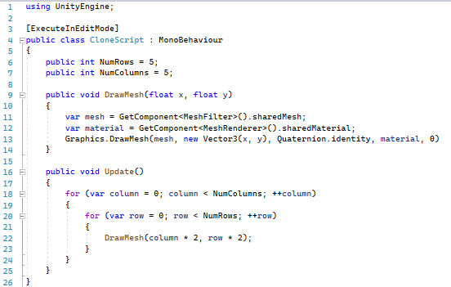
Statements
Statements are sequences of instructions. They might declare something, execute a subroutine, or affect control flow.

Slide 22
For Loop Statement
Calls the next statement (the loop body) multiple times.
Executes an initialization statement before starting.
Only executes while the invariant is true.
After each loop iteration, calls an iteration statement.

Slide 23
Condition
An expression of type Boolean (true or false).
In the context of a for loop is called the invariant.
Loop is executed while condition is true.

Slide 24
Increment Statement
Adds one to a variable.
Returns the value of a variable after adding one to the variable.
The same as “x = x + 1”.
In the context of a for loop, it is called after each loop iteration.

Slide 25
Block Statements
Also called a compound statement.
Allows any number of statements (0 or more) to be treated like one statement.

Slide 26
Function Calls
An expression or statement that executes a function.
If it returns a value, can be used as an expression.
Accepts types and/or expressions as inputs.

Slide 27
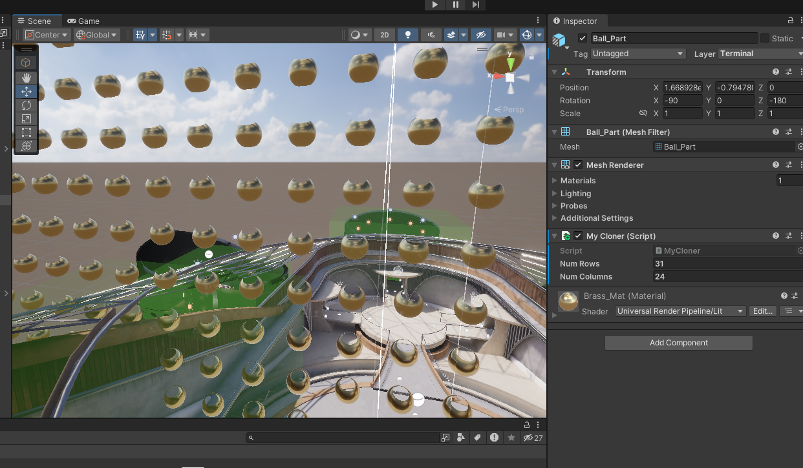

Slide 28

About C#

Slide 29
C# Characteristics
An object-oriented language
Virtually everything is an object (or can be cast to an object)
A garbage collected language
Memory is automatically released when no-longer used
A strongly typed language
Every run-time value has a fixed type
A statically typed language
Every expression and variable has compile-time known type
A reflective language
Can query data types at run-time and use fields & methods
Compiles to byte-code
.NET assemblies contain IL byte-code

Slide 30
What is the point of static typing?
Provides a guarantee of safety during compilation
Helps the compiler produce efficient code
Make a program more predictable

Slide 31

Why C#?
Good tooling
Excellent standard library
Lots of 3rd party libraries
Easy to deploy
Cross-platform
Good performance
Stable
Good interoperability
Convenient syntax

Slide 32
Why not C#?
There is a lot of syntax and some outdated features
Sometimes we need hacks to get good performance
Not a great user experience when run in the browser
Have to restart application sometimes

Slide 33
Last Seven Years of .NET / C#
C# Version | Date | .NET Framework | .NET / .NET Core | .NET Standard | Unity
7.0 | March 2017 | 4.7 | .NET Core 1.1 | 2.0
7.3 | May 2018 | 4.8 | .NET Core 2.2 | 2.0 | 2018.3
8.0 | September 2019 |  | .NET Core 3.1 | 2.1 | 2020.2 (partial)
9.0 | November 2020 |  | .NET 5.0 |  | 2021.2 (partial)
10.0 | November 2021 |  | .NET 6.0
11.0 | November 2022 |  | .NET 7.0
12.0 | November 2023 |  | .NET 8.0
Notes:
What Version to use? - When in doubt, use C# 7.3 and compile libraries with .NET Standard 2.0. Works with the widest range of tools and environments. Especially when you want to do plug-in development and support older Windows tools, or versions of Unity.

Slide 34
Which Editing Environment?
Microsoft Visual Studio
Microsoft Visual Code
JetBrains Rider

Slide 35

C# Project Types we will Cover Today
Console applications
WinForms GUI application (for Windows)
WPF application (for Windows)
Libraries
Unit tests
Unity Scripts [Time permitting]

Slide 36

About Console Applications
A console application (by default) has no GUI
Aka “Command Line Interface” or CLI program
In Unix they are called “filters”
Can be executed with or without a console
Reads from standard input stream
Writes to standard output and error streams

Slide 37

Standard I/O Streams
A very useful thing to learn about on
Relevant from any language and OS
Can be used with shell scripts (DOS batch)
There are three: std in, std out, and std err
Used by OS to redirect input/output between files and processes
Look like and are interchangeable with files

Slide 38

Common Command-Line Programming Tasks
Read or Write to a File or Stream
Respond to network requests
Perform a Computation
Launch a Process
Examine/set environment variables
Parse command-line arguments

Slide 39
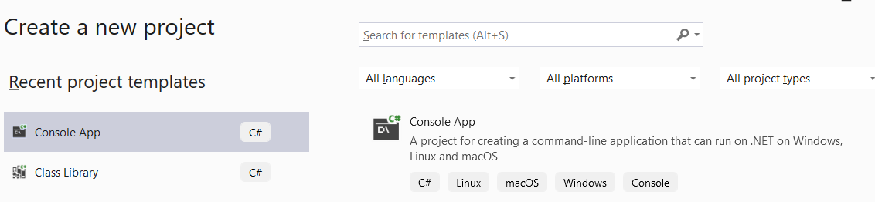
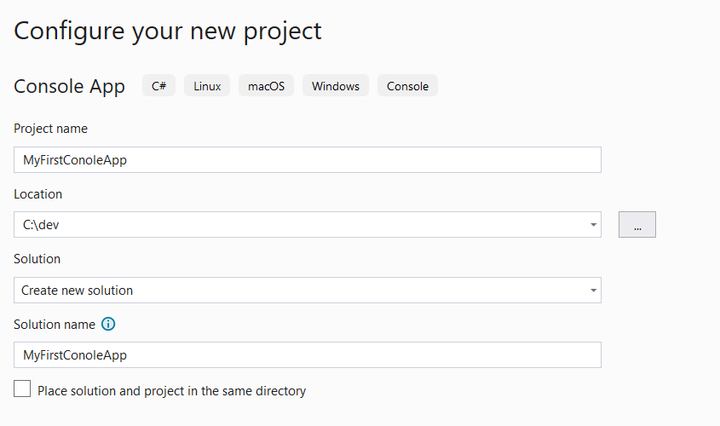
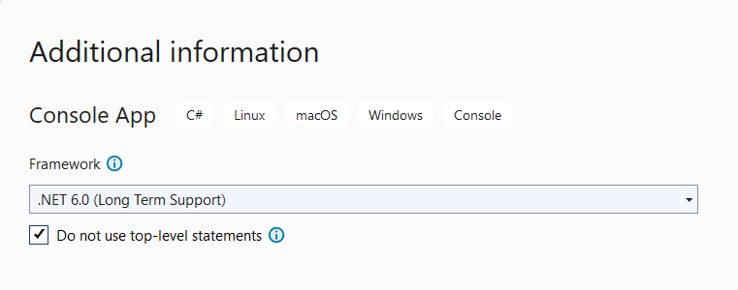
Let’s Make a Console Application
2
1
3

Slide 40
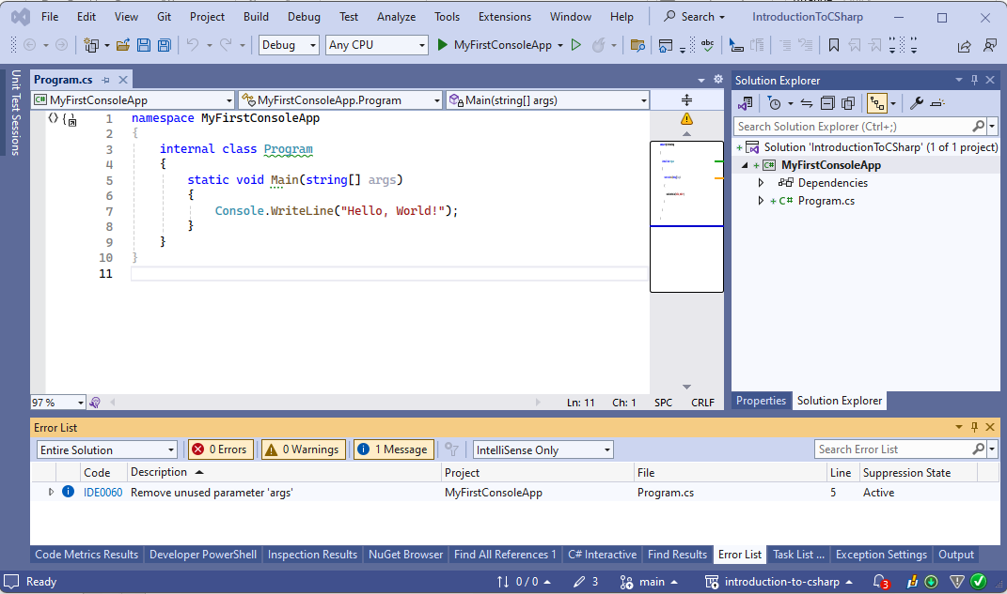
What you will see …

Slide 41
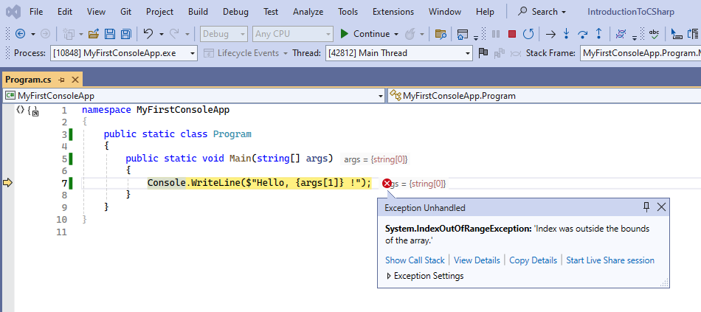
My First Error

Slide 42
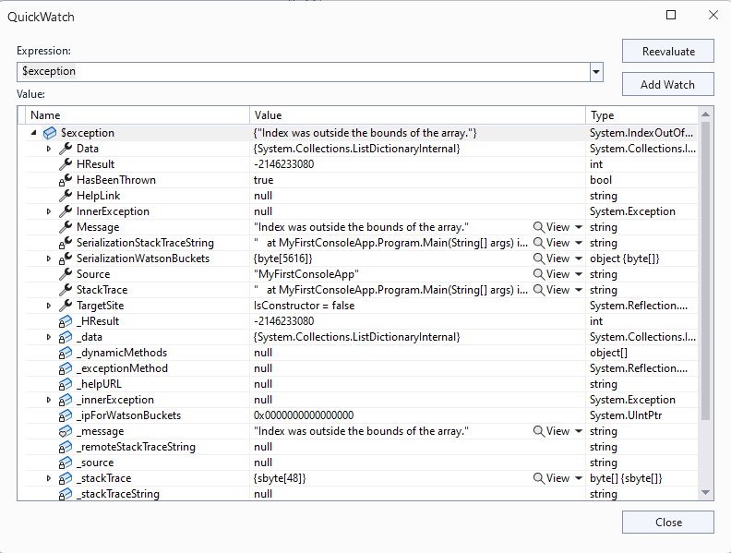

Showing Details shows us Much Details

Slide 43
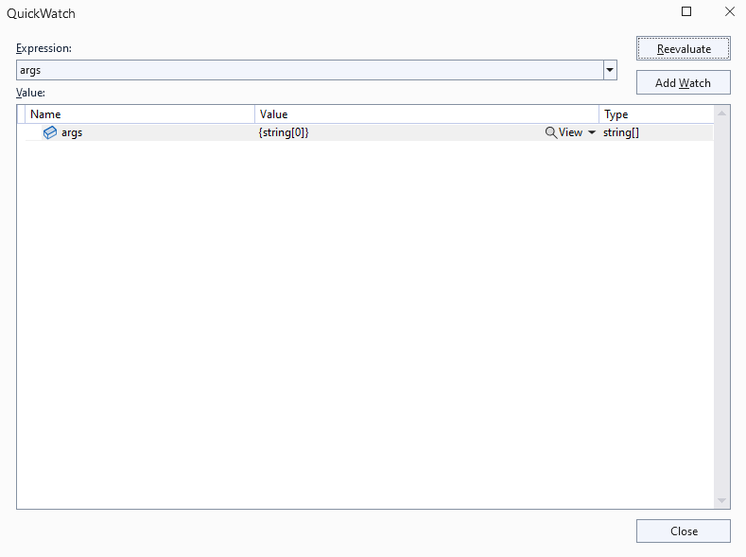
Changing the Expression gives us more clues

Slide 44
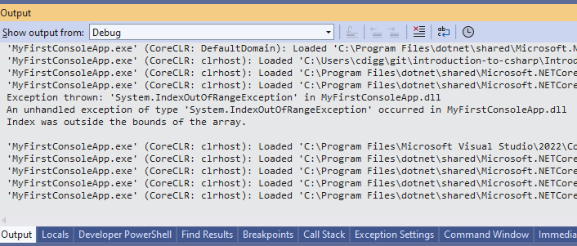
Okay I get the point

Slide 45
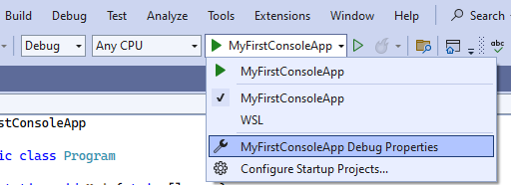
But why? The answer lies in debug properties

Slide 46
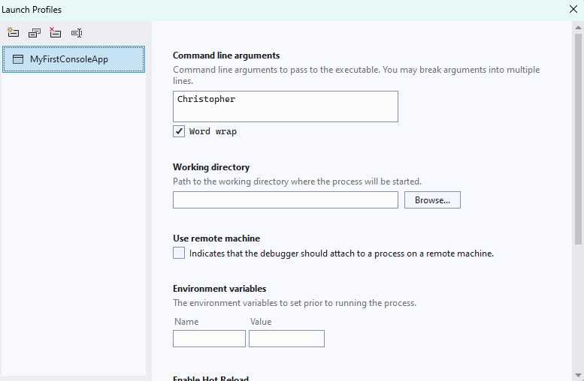
We can specify command line arguments, working directory and environment variables.

Slide 47
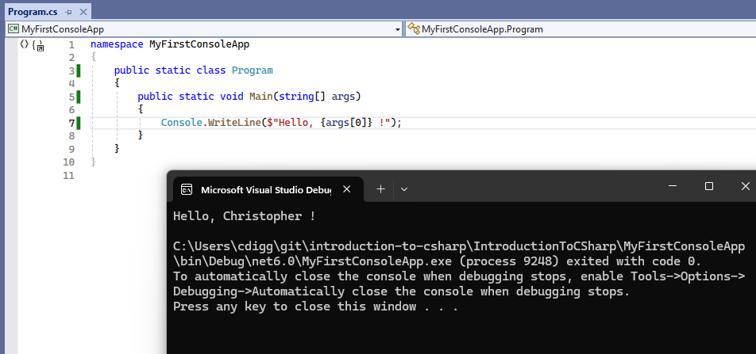
Woohoo, some success!

Slide 48
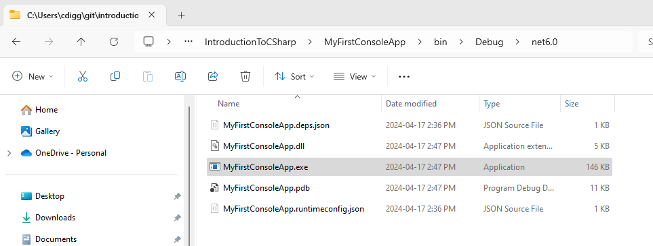
The generated files

Slide 49
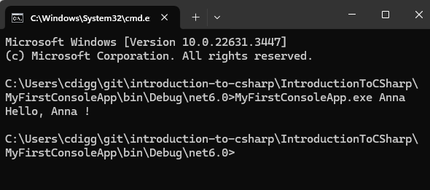
Which we can run from “cmd.exe” (aka the command line)

Slide 50

C# Launching a Process and Redirection
Launching a process
Redirect standard-input of process
Redirect standard-output of process
Redirect standard-output of current program

Slide 51
C# Streams
A stream is a read-only or write-only sequence of data
Usually, characters or bytes
StreamWriter writes characters to a stream
StreamReader reads characters to a stream
Console.WriteLine() writes to standard output
Console.ReadLine() reads from standard input
Streams are opened or closed
Usually unidirectional (can’t back up unless buffered)

Slide 52
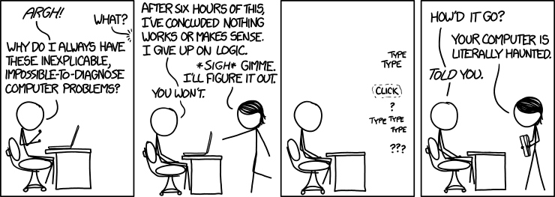
Debugging (and a bit of testing)
https://xkcd.com/1316/
By Randall Munroe

Slide 53

My view on Bugs … 🐛
There are no bugs
Just confused programmers …
Computers do exactly what they are told.

Slide 54

Debugging
Don’t delay learning debugging tools
It speeds up development and learning.
C# makes it about as easy as possible

Slide 55
Breakpoints and Pausing Debugger
A marker assigned to a statement that triggers debugger to pause.
Exceptions also can trigger debugger pauses
Programmatically you can use:
Debugger.Break() to pause
Debugger.Launch() to launch and attach debugger

Slide 56
Stepping Through Code
When debugger is paused you can step through code
Resume execution
Pause execution
Stop debugging (usually stops program)
Restart execution from beginning
Step over any function calls
Step into any function calls
Step out of current calls

Slide 57
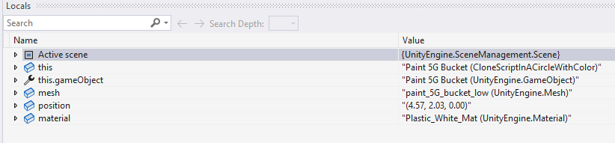
Watches
A window that shows the value associated with an expression.
We can view all local variables or specific expressions.
For more information on using watches see this article.

Slide 58
Tests! 👩‍🔬
Tests are a powerful debugging tool
Check that functions do what you think they should
Can be used to do exploratory coding
Can also be used to write one-off tools, without creating a project

Slide 59
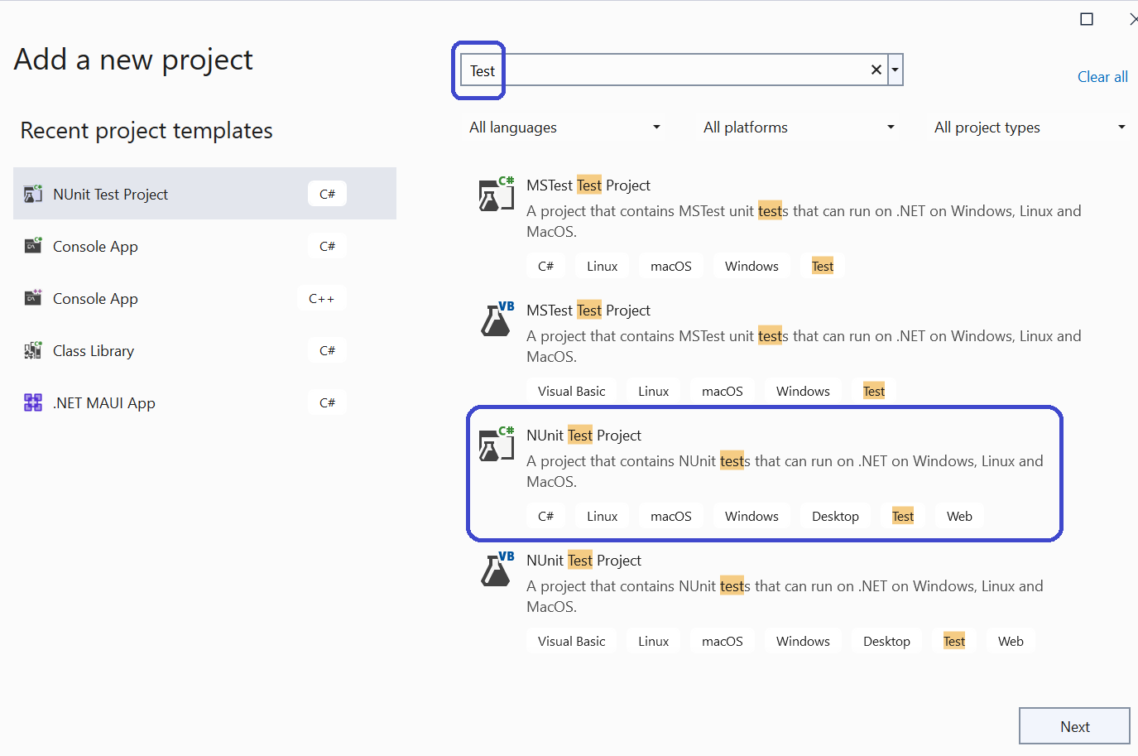
Test Projects: A special kind of library

Slide 60
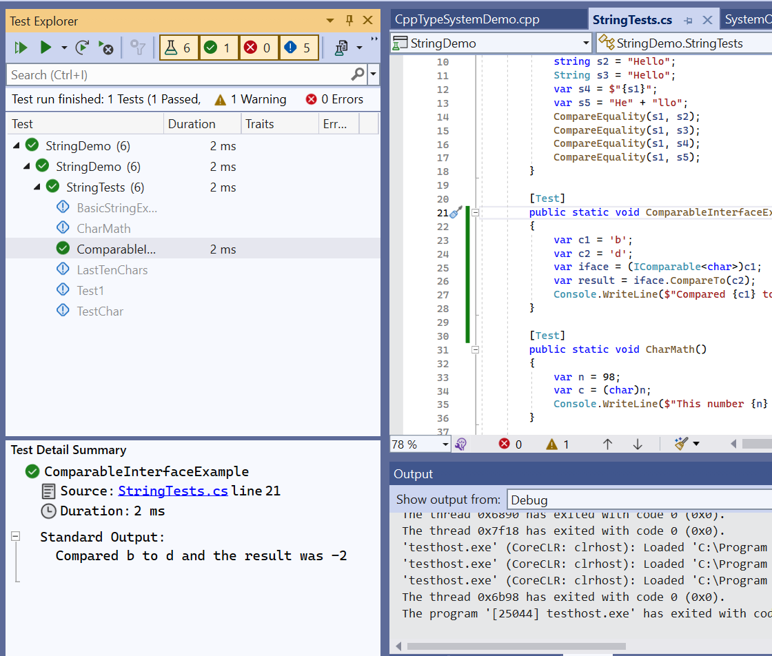
The Test Explorer Window

Slide 61

Class Libraries
Class libraries are a secret weapon
Putting code in a library simplifies problems
Provides opportunity to reuse solutions
Saves time and reduces complexity

Slide 62

.NET Assemblies
Class libraries are also called “assemblies”
They have a .DLL extension
They consist of IL byte-code
They can be inspected programmatically
They can be easily loaded dynamically
They can be easily decompiled
BTW .NET exe files are also assemblies!

Slide 63
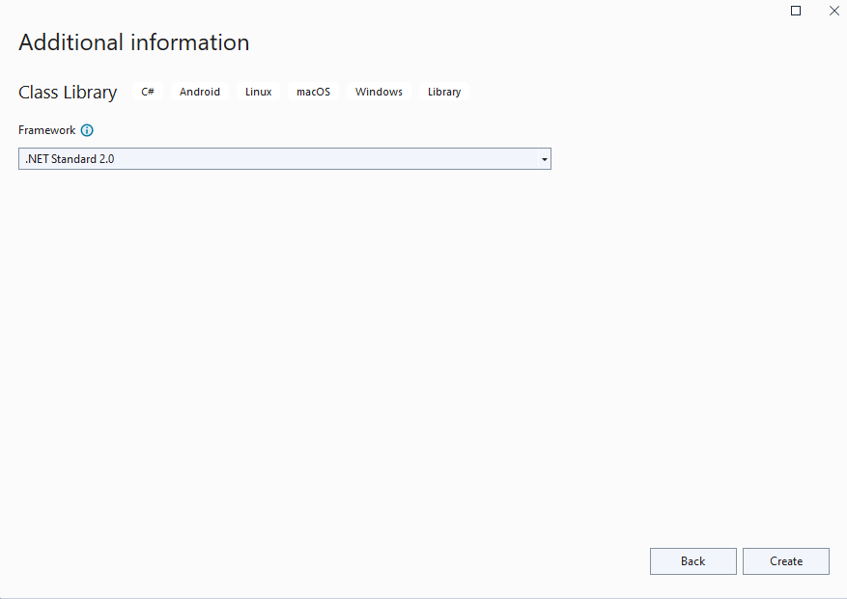
Use .NET Standard 2.0 for Compatibility

Slide 64
About .NET Standard 2.0
Compatible with .NET 4.7, .NET Core 2.1, and Unity 2018.3
Compatible with C# 7.3
But, only for libraries not executables or tests
Great for cross platform compatible code
Important for plug-ins to run on older versions of tools

Slide 65
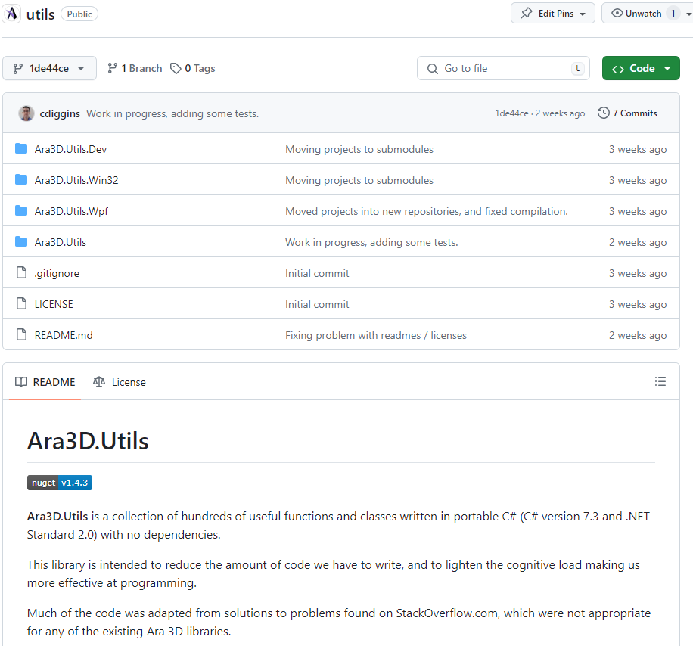
Ara3D.Utils
I have a ton of libraries
They make my life easier.
They are my “Batman utility belt”

Slide 66

The Basics of a Graphical User Interface
A GUI executes within the context of a window manager.
A hidden loop dispatches windows messages to your code.

Slide 67
Choosing a C# GUI
WinForms is quickest to learn and start using.
For Windows only .
WPF is significantly more powerful and flexible
For Windows only
MAUI is a cross-platform mobile app UI framework
A successor to Xamarin
ASP.NET
For web-based UI
3rd party options:
Avalonia UI - https://avaloniaui.net/
Uno - https://platform.uno/

Slide 68
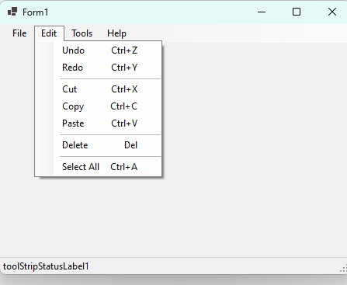
WinForms is from 1995 … but so what?

Slide 69
Using Events
Events are functions you write called in response to user input
Also called callback functions or delegates

Slide 70
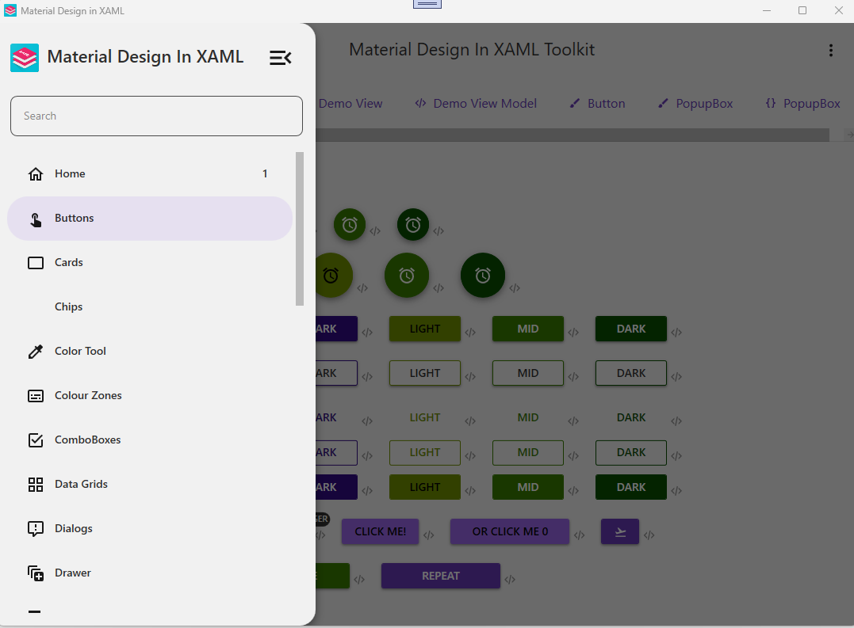
WPF is more modern (relatively) and Flexible

Slide 71
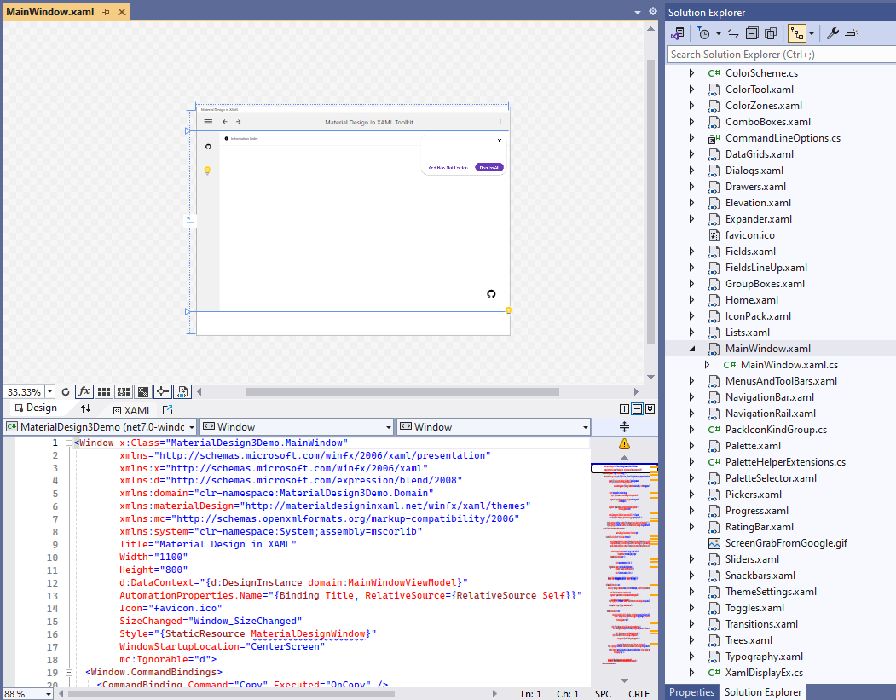
Windows Presentation Framework (WPF)
Uses XAML to express layout and basic UI concepts
Uses data-binding to decouple presentation from business logic
Also very old, but more modern than WinForms
Currently best option for Windows desktop UI

Slide 72
XAML
An XML based declarative language
Specifies relationships and properties of graphical components
Maps to constructors and initializers in code behind
Has special embedded language for expressing bindings

Slide 73
Code Behind
This is the code that is generated from XAML files
Instead of using XAML we can use code-behind
It can beeasier for new programmers

Slide 74
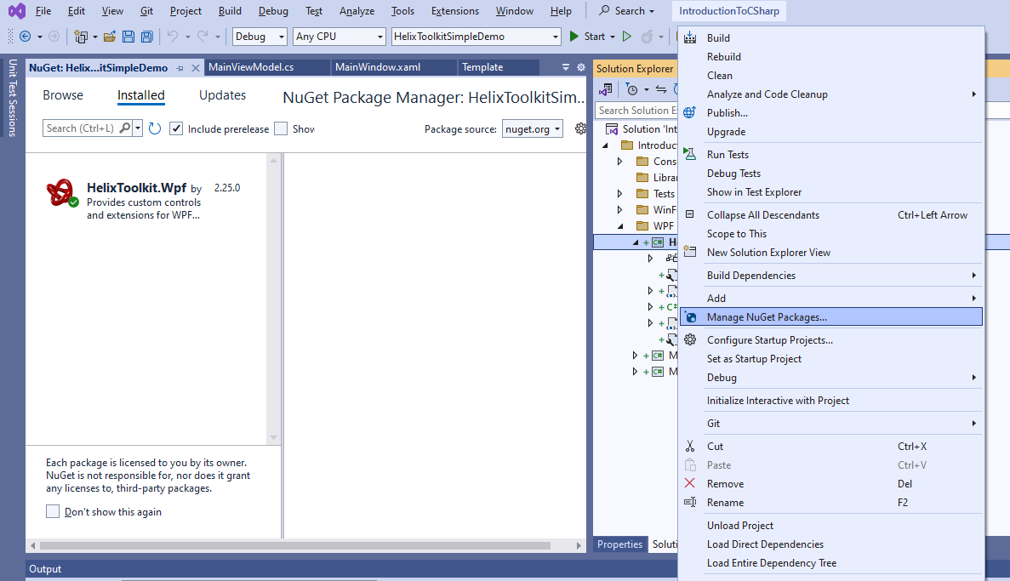
Nuget – C# Package Manager

Slide 75
Common Statements
Return statement return (a * x * x) + (b * x) + c;
Variable declaration var a = 42;
Assignment statement x = Quadratic(1,2,3,4);
Function call statement Debug.Log("hello");
For statement for (var i=10; i > 0; i--) Console.WriteLine(i);
Foreach statement foreach (var x in myCollection) Console.WriteLine(x);
While statement while (true) Console.WriteLine(“y”);
Break statement break;
Continue statement continue;
Block statement { }

Slide 76
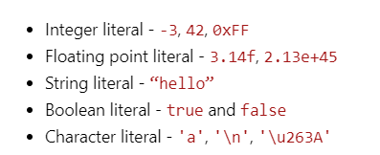
Literal Expressions
A literal expression is a representation of a value directly in code.

Slide 77
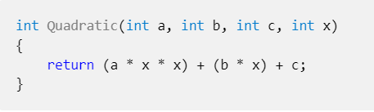
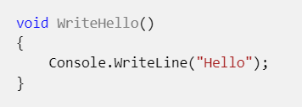
Functions
A function in programming is a code block that has zero or more input values (parameters), and an optional output.
Unlike functions in mathematics, they don't have to have a return value and may cause side-effects to happen

Slide 78
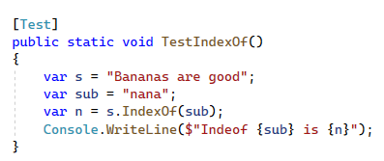
String.IndexOf Demo

Slide 79
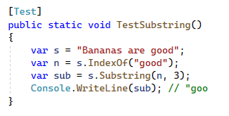
String.Substring Demo

Slide 80
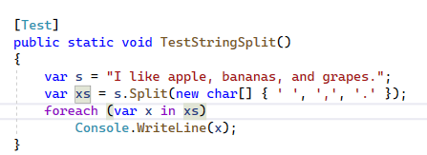
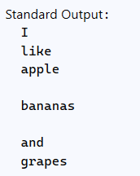
String.Split() Demo

Slide 81
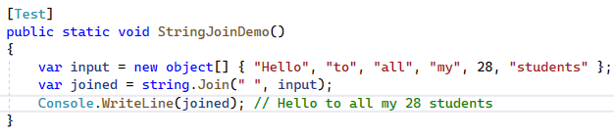
String.Join Demo

Slide 82
Collections of things
A collection is a value that contains other values.
A collection has items of the same type.
Examples include arrays, stacks, set, dictionaries, and lists.
We can get far with just using lists (dynamic arrays).

Slide 83
List<T>
Items of the same type.
xs = new List<Vector3>();
Add, remove, and insert items:
xs.Add(), xs.Remove(), xs.Insert()
Query the count:
xs.Count
Retrieve specific elements:
var v = xs[3];
Change specific items:
xs[i] = new Vector3(0, 2, 0);

Slide 84
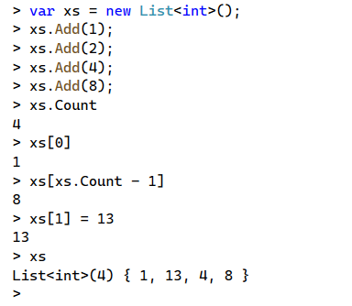
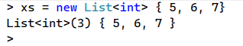
List<T> Example

Slide 85
Indexing
Lists and Arrays use an integer index for each item
Indices start at 0
You can retrieve an item: myList[index]
You can modify an item at a position: myList[index] = 12
The last item in a list is: myList[myList.Count – 1]

Slide 86
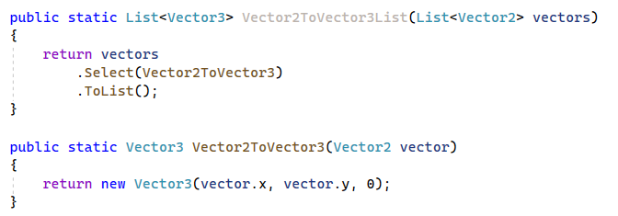
Converting a List of X into a List of Y
A select statement takes a function as an argument
Transforms collection, by applying function to each element

Slide 87
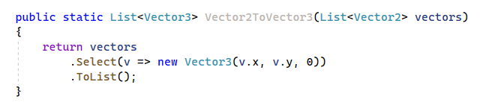
Using Anonymous Functions (Lambdas)
Anonymous functions (lambdas) simplify syntax
Types of parameters are inferred

Slide 88
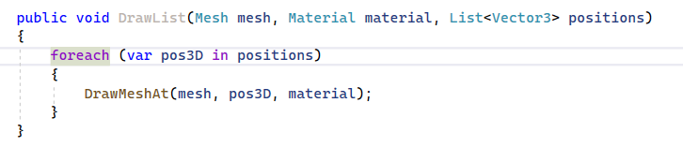
Using “Foreach”
A foreach is a loop statement designed for IEnumerable<T>.
Easier to type and read
Visits each element in sequence

Slide 89
IEnumerable<T>
An IEnumerable<T> is a generalization of collections
Enumerating means visiting each item in order one by one
To access an element, you must walk through items one by one
To get the count, you must visit each item until the end
Be careful: can sneakily increase computational complexity.

Slide 90
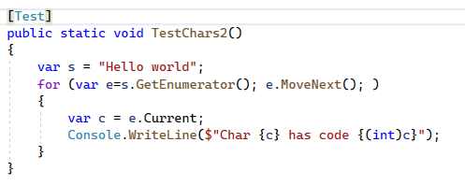
Foreach is a For Loop
https://learn.microsoft.com/en-us/dotnet/api/system.collections.ienumerable.getenumerator?view=net-7.0

Slide 91
Basic IEnumerable<T> Operations
Select - Transform each item into a new one using a function
Where - Filter a collection by checking against a conditional function (predicate)
Aggregate - Combine elements using a function (generalization of sum)

Slide 92
Converting a List of X into a List of Y
A select statement takes a function as an argument
Transforms collection, by applying function to each element

Slide 93
Using Anonymous Functions (Lambdas)
Anonymous functions (lambdas) simplify syntax
Types of parameters are inferred

